Slide 1
Global Brand Protection Illicit Trade Fingerprinting
January 2016

Slide 2
Introduction
Illicit Johnson and Johnson products costs the company a significant amount each year.
Many sources of illicit products use marketplaces such as Ebay, Alibaba, and MercadoLibre to sell their products
Given a limited amount of resources, we want to find the most effective way to combat illicit trade

Slide 3
Objectives
Quantify the similarity of a online marketplace listings and their sources by way of a “digital fingerprint”.
Identify key players in the illicit trade market to improve allocation of Global Brand Protection resources.
The goal is to better understand the illicit trade network in order to allow J&J to better combat illicit trade of its products

Slide 4
Analysis Strategy
Develop “fingerprints” for different sources based on their listings
How are their listings formatted?
What kind of words do they use in the title and description?
What images do they use for their listings?
By creating “fingerprints” for each source, we can tell which listings each source is responsible for

Slide 5
Overview
Listing URLs
Extract Data from URL
Username Comparison
Title Similarity
Text Similarity
Image Analysis
Create Network
Identify Clusters

Slide 6
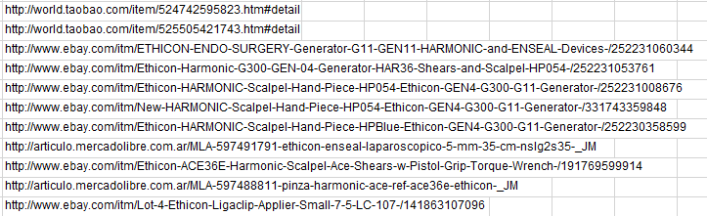
Original Data
Started with vendor data including a list of URLs of illicit listings

Slide 7
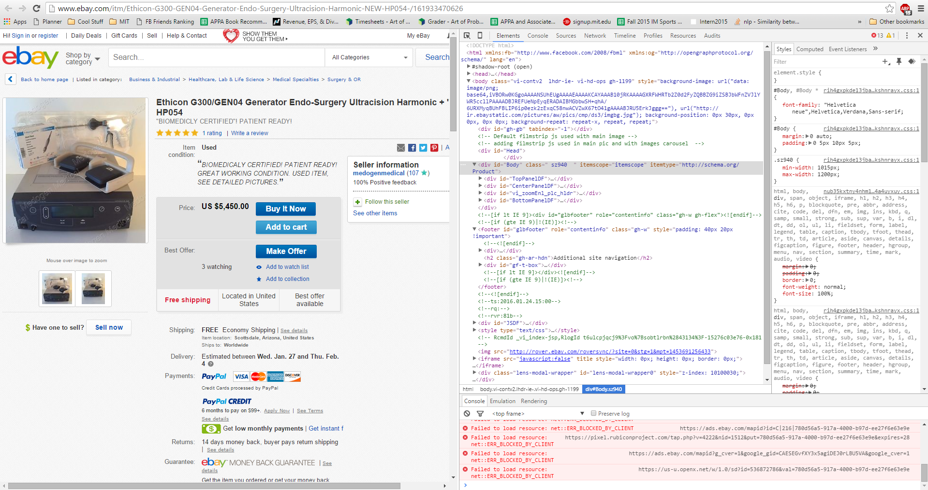
Extracting Information
Scraped useful information from each URL’s webpage

Slide 8
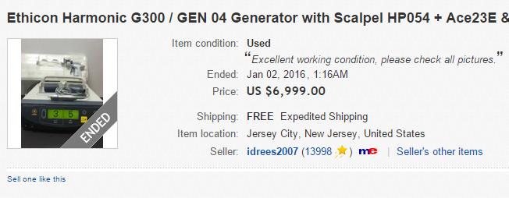
Username Comparison
Listings with the same usernames are related
Provides a preliminary understanding of the illicit trade network
Username

Slide 9
Title and Text Similarity
Text from the title and description of the listing are analyzed by finding the document distance.
Sources using multiple accounts are likely to reuse similar titles or descriptions for their listings
A score close to one means the two texts are similar
Analysis works regardless of language
This is a random sentence of words This is also a random sentence of words | Score : .935
This is a random sentence of words I don’t know what you’re talking about | Score : 0
This is a random sentence of words That’s so random! | Score : .21

Slide 10

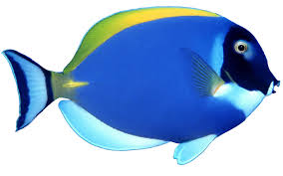
Image Analysis
Images from different listings are compared using the dHash (difference hashing) method by hashing the pixels to see if they are identical
Comparison method employed allows for small differences between images
Listings which have identical images are likely to be related
=
≠

Slide 11
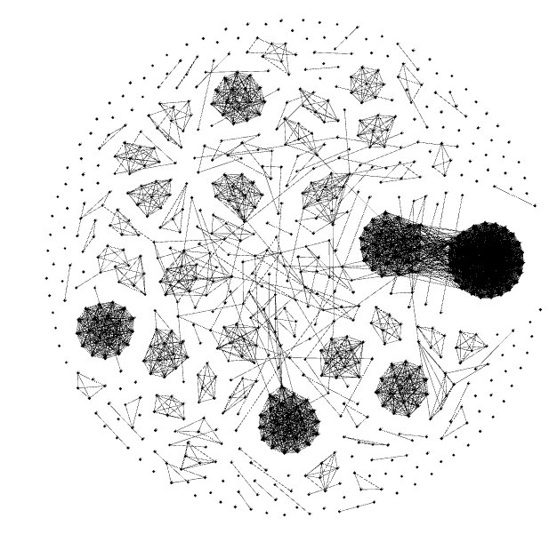
The Ebay Network
Each node represents a different URL
Edges between nodes mean that one or more properties (Seller, Title, Text, or Images)

Slide 12

Findings – Username Comparison
Each color represents a different seller
Clustering algorithm employed which groups listings of the same seller together

Slide 13
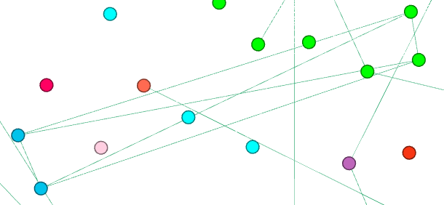
Findings – Title Similarity
Filtered edges such that green lines mean that the listings are related by title
Listings with extremely similar titles are a sign that they originate from the same source
In the example, djenky99 and surgical-overstock appear to be the same source
http://www.ebay.com/itm/ACE36E-Ethicon-Harmonic-Ace-Curved-Shears-ea-x-R-/262195246325
http://www.ebay.com/itm/ACE36E-Ethicon-Harmonic-Ace-Curved-Shears-ea-x-/121843954996

Slide 14
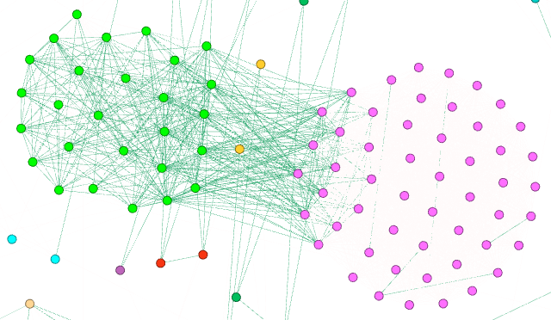
Findings – Text Similarity
Filtered edges such that green lines indicate that the listings are related by text
Example suggests that the two biggest sellers, tridentmedical-llc and surgical-overstock are from the same source
http://www.ebay.com/itm/NSLG2C35A-Ethicon-Enseal-G2-Curved-Tissue-Sealer-5mm-x-35cm-x-/161675995100
http://www.ebay.com/itm/ACE23E-Ethicon-Harmonic-Ace-Curved-Shears-23cm-ea-x-R-/262145000128?hash=item3d090f42c0:g:Le0AAOSwu4BV3eWe

Slide 15
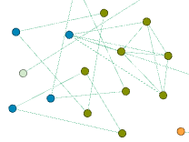
Findings – Image Analysis
Filtered edges such that green lines represent listings with identical images
In the example, the analysis suggests that medi.surgical and themoreforu are from the same source
http://www.ebay.com/itm/Laprascopy-Needle-Holder-carbide-Tip-curved-TC-Ethicon-5-mm-/181722655501
http://www.ebay.com/itm/New-SS-Laparoscopic-Surgery-Needle-Holder-carbite-Tip-curved-TC-Ethicon-Type-5mm-/111849135478

Slide 16
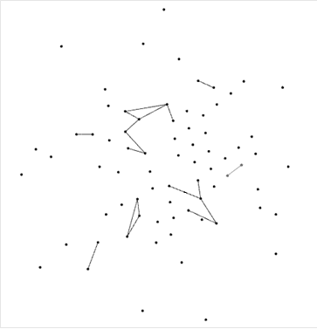
Findings – Ebay Seller Network
Network of users that have 3 or more listings (Users with fewer listings were removed)
Users are related they have listings which are related
Each cluster of virtual users possibly correlates to one source

Slide 17
Findings – Largest User Clusters
21.55%: tridentmedical-llc, surgical-overstock, m.instrumentscorp, djenky99, medogenmedical
6.46%: etechlab, secondchancemedical, therightstuff619, amdamom, supplyresource, tools4docs, f512bb
3.66%: collectibles-n-more, excessmm
3.23%: lapsurgsolution, mstmedicalsalesva, whittemore_enterprises
2.80%: themoreforu, medi.surgical
2.58%: bststuff4u, nationalmedicsales
1.50%: laloomedicalusa, tech1365
7
2
6
3
4
1
5

Slide 18
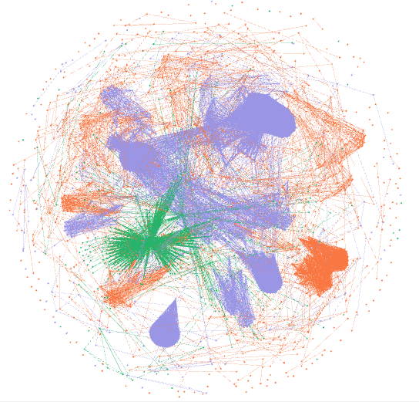
Findings – Multiple Marketplaces
Graph contains information for Ebay (orange), Alibaba (blue), and MercadoLibre (green)
Further analysis is required

Slide 19
Summary
After 3 weeks and 1000+ lines of code, we’ve…
Scraped, stored, and analyzed data from thousands of URLs
Created a graph representing the illicit trade network
Used the network to fingerprint and identify a list of the largest sources of illicit products
21.55%: tridentmedical-llc, surgical-overstock, m.instrumentscorp, djenky99, medogenmedical
6.46%: etechlab, secondchancemedical, therightstuff619, amdamom, supplyresource, tools4docs, f512bb
3.66%: collectibles-n-more, excessmm

Slide 20
Limitations
Need different web scraper for each marketplace
Possible false positives, especially with images
Transitive property may not hold
Listings removed before data could be stored

Slide 21
Moving Forward
Collect information and perform analysis on additional marketplaces.
Implement additional analysis techniques which provide stronger correlations and take into account additional information
Find ways to reduce the chance of false positives

Slide 22



Technologies Used
Python
xlrd to pull data from Excel files
scrapy to scrape data from website listings
pymongo, bson to manipulate MongoDB
nltk to calculate tf-idf matrix for text analysis
httplib2, urllib, cStringIO to pull online images
distance to calculate levenshtein distance
pandas to create a dataframe to export data
networkx to create a network for Gephi
MongoDB
Gephi

Slide 23
Thank You!

